Slide 1
FAKE NEWS DETECTIONS

Slide 2
Introduction
In the digital age, news spreads quickly via social media, blogs, and online platforms.
Alongside fast information access, the spread of fake news has become a major issue.
Fake news: Deliberately false or misleading information presented as legitimate news.
It can influence public perception, cause panic, and erode trust in media.

Slide 3
Problem Statement
Online news and social media have grown exponentially, making it harder to distinguish real news from fake news.
Fake news spreads rapidly, influencing elections, causing unrest, and affecting public health.
The general public finds it challenging to verify the authenticity of online content.

Slide 4
Objectives
To develop a machine learning-based system to automatically detect fake news from text data.
To compare the effectiveness of multiple algorithms like Logistic Regression, Naive Bayes, and Random Forest in classifying news.
To evaluate the system’s accuracy and reliability using standard performance metrics.

Slide 5
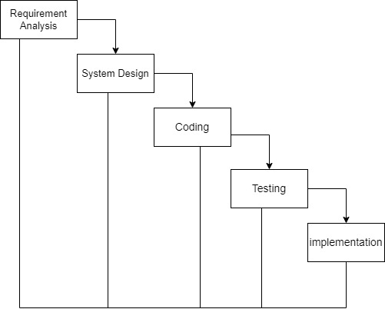
Development Methodology

Slide 6
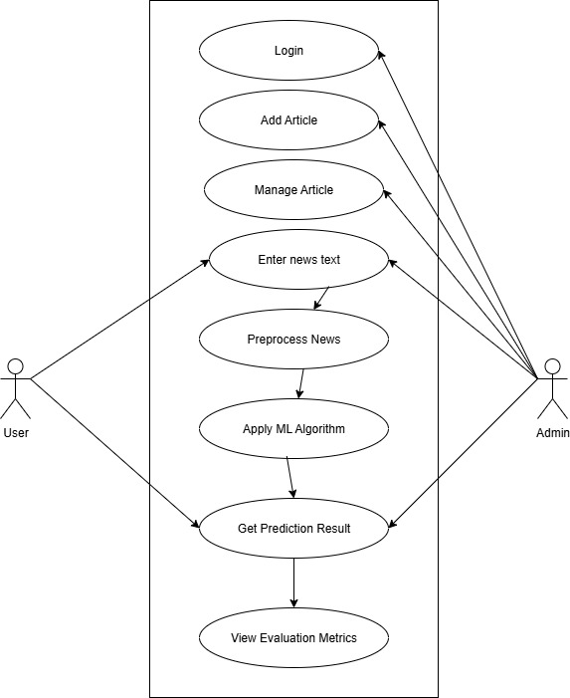
Use-Case Diagram

Slide 7
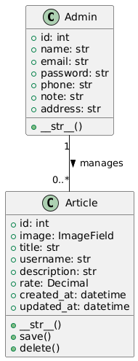
Class Diagram

Slide 8
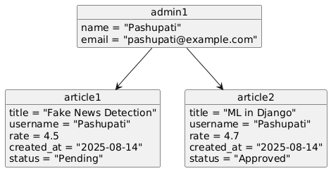
Object Diagram

Slide 9
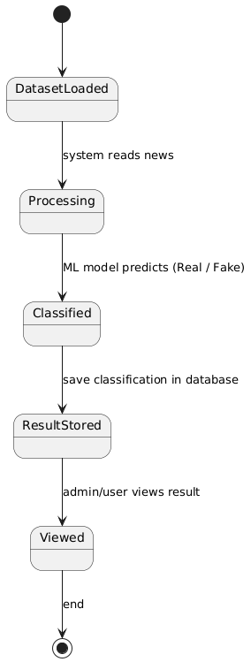
State Diagram

Slide 10
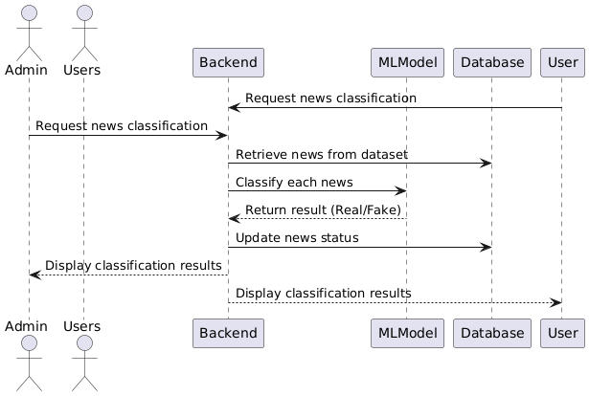
Sequence Diagram

Slide 11
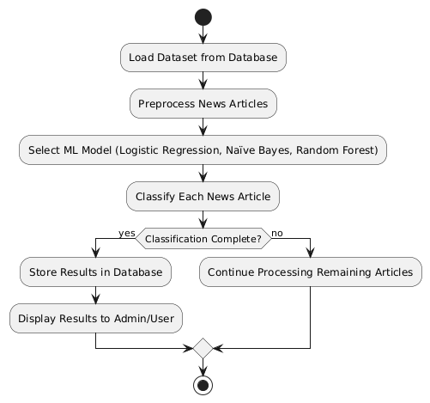
Activity Diagram

Slide 12
Algorithm Details
1. Logistic Regression
Preprocess dataset: clean text, remove stop words, tokenize, convert to numeric features (e.g., TF-IDF).
Split dataset into training and testing sets.
Apply linear equation to compute probabilities (0–1) for each class.
2. Naive Bayes
Uses Bayes’ theorem assuming feature independence.
Features: presence/frequency of words in articles.
Calculates posterior probability for each class (Real/Fake).
3. Random Forest
Builds multiple decision trees on random subsets of data.
Each tree predicts independently; final output via majority voting..

Slide 13
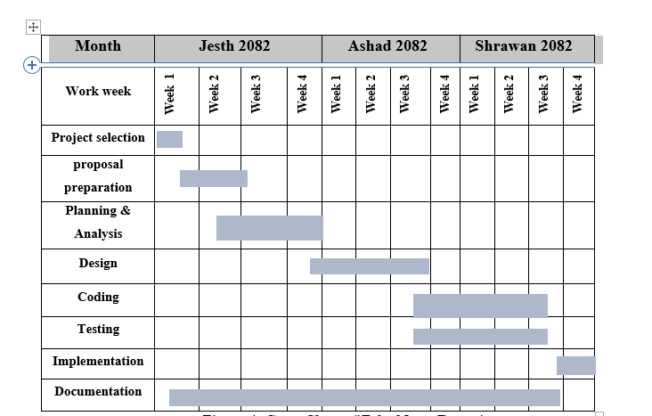
Gantt Chart

Slide 14
Expected Outcome
The system will accurately classify news articles into fake or real categories using multiple machine learning algorithms.
It will provide a user-friendly interface for users to input news text and receive instant predictions.
The system will display performance metrics such as accuracy, precision, recall, and F1 score to evaluate model effectiveness.

Slide 15
References
[1] N. J. Conroy, V. L. Rubin, and Y. Chen, "Automatic deception detection: Methods for finding fake news," in Proceedings of the 78th Annual Meeting of the Association for Computational Linguistics, 2015, pp. 250–255.
[2] J. Devlin et al., "BERT: Pre-training of deep bidirectional transformers for language understanding," in NAACL-HLT, 2019, pp. 4171–4186.
[3] European Commission, "Code of Practice on Disinformation," 2018. [Online]. Available: https://ec.europa.eu/newsroom/dae/document.cfm?doc_id=54454
[4] V. Pérez-Rosas, B. Kleinberg, A. Lefevre, and R. Mihalcea, "Automatic detection of fake news," in COLING, 2018, pp. 3391–3401.
[5] V. L. Rubin, N. J. Conroy, Y. Chen, and S. Cornwell, "Fake news or truth? Using satirical cues to detect potentially misleading news," in Proceedings of the Second Workshop on Computational Approaches to Deception Detection, 2016, pp. 1–4.

Slide 16
Thank You

